Slide 1
Psychological test: Minnesota Multiphasic Personality Inventory-II
Student Name:
Course Name:
Institution Affiliation:

Slide 2
Development of MMPI and its Rationale
This test was developed in 1930’s In the Minnesota University by a psychiatrist known as J.C McKinley and psychologist called Starke R. Hathaway.
It appears to be the most widely used psychological test in assessing, diagnosing and identifying mental-related illness in clinical psychology (Butcher, 2014)
Also used in other fields apart from clinical psychology. For instance, it’s used in legal area especially custody related disputes and criminal defense.
Administration: group or individual; 1 to 1.5 hours.
Notes:
Individuals tested should have at least 16 years and about 6 years in Interpretation for the results is strictly done by professionals or epysychologists.

Slide 3
MMPI-II measurements
Has 567 items to be answered.
Has 10 scales for measuring various things.
Scale 1(Hs)- Hypochondriasis(32 items)
Scale 2(D)-Depression(57 Items)
Scale3(Hy)-Hysteria (60 items)
Scale 4 (Pd)- psychopathic deviance(50 items)
Scale 5 (MF)- Masculinity/Feminity (56 Items)
Scale 6 (Pa)- Paranoia (46 items )
Scale 7 (Pt)- Psychasthenia (48 items)
Scale 8 (Sc)- Schizophrenia (78 items)
Scale 9 (Ma)-Hypomania (46 items)
Scale 10 (Si)-Social Introversion (69 Items)
Notes:
Code types given are interpreted as a single , wider ranged elevation instead of making individual scale interpretation. They are combined to give different summations depending on scales chosen.

Slide 4
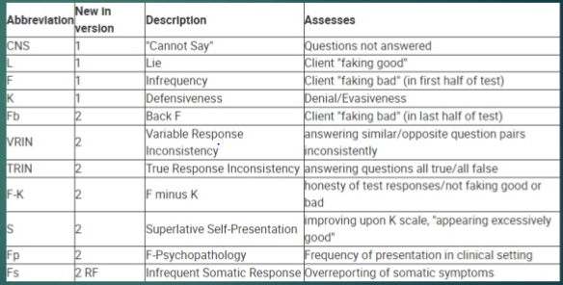
Validity scale, frequency distribution and measures of central tendency
Validity scale
This include omitted items, L-scale, F-scale, K-scale
These scales give different impressions to the professional analyst.
Frequency distributions
The variations or number of appearances of an item is represented on frequency distribution table which may be in frequency of outcomes against a various categories or inconsistent/fake responses per category.
Measures of central tendency
Include mean, mode or median mathematically calculated
Measures of variability
MMPI-Validity Scale
Notes:
Mean is got from the averaging the scores got. Median serves as the middle score based on their arrangement from the highest value to the lowest. Mode serves as the score which has appeared most. Based on this, range of T scores normally lies within the range 50 to 65 (Murphy, 2008). Any score below or above calls for clinical interpretation.

Slide 5
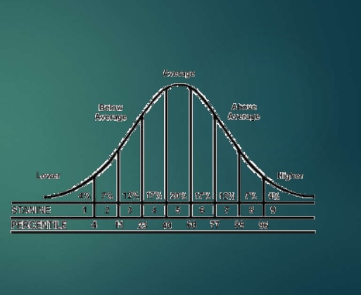
Measures of variability, reliability and validity
Percentiles- They compare how the test group compares with others who took the same test.
Standard scores-shows deviation of values compared to the mean value.
Percentile ranks- allows categorization of examined subjects to their specific quadrants where 50 is taken as the mean, the lowest value as 1 and the highest as 100.
Reliability can be classified into test-retest, alternative form and split-half reliabilities. Depending on number of times administered and Results achieved.
Norms?
Variability measures
Notes:
spreading of scores in relation to the mean score is represented by standard deviation. The Standard deviation for MMPI-II is 10(Murphy, 2008).
On norms. Following many translations done by developers it has been found that the mean scores for MMPI-2 scales for any target country lie within the standard measurement error for the American norms (Hathaway, 2009). This makes the various interpretation for this test to be universally accepted.

Slide 6
References
Butcher, J. N., Atlis, M. M., & Hahn, J. U. N. G. W. O. N. (2014). The minnesota multiphasic personality inventory–2 (MMPI-2). Comprehensive handbook of psychological assessment: Personality assessment, 30-38.
Murphy, K. R., & Davidshofer, C. O. (2008). Psychological testing. Principles, and Applications, Englewood Cliffs.
Hathaway, S. R., McKinley, J. C., & MMPI Restandardization Committee. (2009). MMPI-2: Minnesota Multiphasic Personality Inventory-2: manual for administration and scoring. University of Minnesota Press.

